Slide 1

Mini Project (KCA353) Odd Semester Session 2024-25
Timeless Haven (GD 07)
Presented By
Lakshay Goel : 2300290140094
Mohammad Aamir : 2300290140103
Rajat Sinha : 2300290140133
Preet Gupta : 2300290140127
Project Supervisor:
Ms. Neelam Rawat
(Associate Professor)

Slide 2
CONTENT
Introduction (1 slide)
Literature Review (1 slides)
Objective of the Project (1 slide)
Technology
Hardware Requirements (Development Environment, Server requirement (if required), Client requirement (if required).
Software Requirements (Language and Platforms like Frameworks, VS code, Android Studio and Jupyter notebook etc. )
Modules (1 slides)
Workflow (1 slide)
Reports (For Example: Project : Student Monitoring System, so reports like: Student Marks, Subjects, companies visit, and student appears in placement etc.)
References (1 slide)

Slide 3

TIMELESS HAVEN
Welcome! This presentation outlines the development of an e-commerce Home Decor website specializing in bedding styles. The website will offer customers a curated selection of high-quality bedsheets, with a focus on design and comfort.

Slide 4
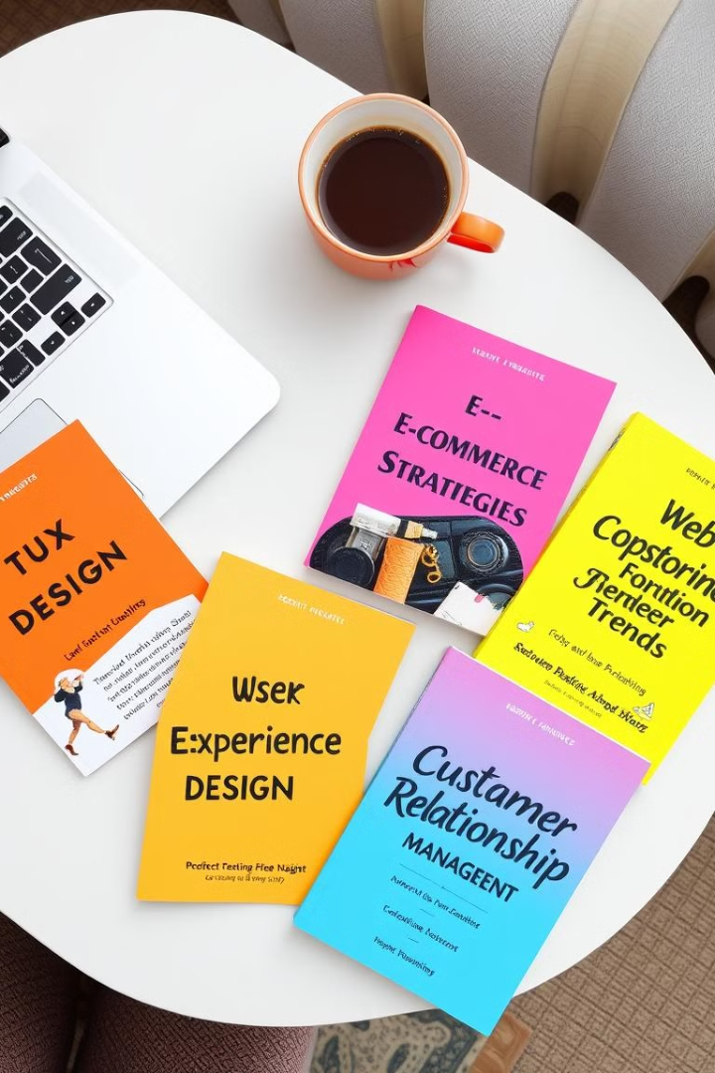
Literature Review
We reviewed existing e-commerce platforms selling home textiles to understand current trends and identify potential opportunities.
1
User Experience
2
Product Catalog
We analyzed user interface designs and navigation features of existing websites to ensure our website provides a seamless and intuitive user experience.
We studied the product cataloging methods of successful e-commerce platforms, focusing on detailed product descriptions and high-quality photography.
3
Marketing Strategies
4
Payment and Shipping
We researched successful marketing strategies for e-commerce websites, including search engine optimization, social media marketing, and email campaigns.
We examined various payment gateways and shipping methods used in the industry to select the most efficient and secure options for our platform.

Slide 5
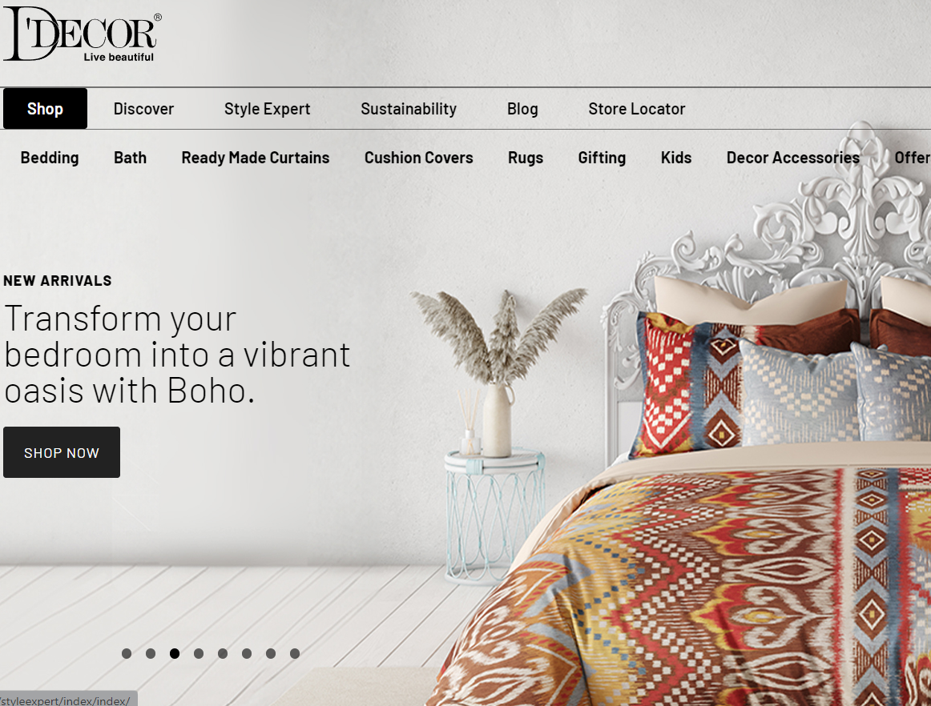
Objective of the Project
The objective of this project is to develop a user-friendly and visually appealing e-commerce website offering a diverse range of bedsheet styles to cater to a wide customer base.
Enhanced User Experience
Provide a Personalized Shopping Experience
To provide a seamless and intuitive browsing experience for customers, with easy navigation and product discovery.
Offer a wide range of bedsheets that cater to different tastes, styles, and preferences through customizable options such as fabric, size, color, and design.
Secure and Efficient Transactions
Expand Market Reach
To ensure safe and convenient online payment and delivery options for customers, prioritizing secure payment gateways and reliable shipping services.
Allow businesses to reach a global audience, making it easier to attract customers beyond geographic limitations.
Provide Secure and Reliable Shopping
Optimize Business Operations
Ensure a safe shopping environment with secure payment methods, data protection, and easy return policies to build customer trust.
Allow businesses to reach a global audience, making it easier to attract customers beyond geographic limitations.
Enhance Customer Convenience
Offer a seamless and user-friendly shopping experience where customers can browse, compare, and buy products from home.

Slide 6
MongoDB(Data Base)
Store Product and User Data: Manage product catalog (decor items, categories, prices) and user information (login details, orders).
Technology
MERN Technology will be used in our project
Next.js (Frontend)
Dynamic UI: Build interactive product pages, shopping cart, and checkout
Responsive Design: Use basic CSS frameworks like Bootstrap or Tailwind CSS..
Express.js(Backend)
REST API: Handle routes for fetching products, user authentication, cart, and orders
Middleware: Use for authentication (JWT) and data validation..
Store Product and User Data: Manage product catalog (decor items, categories, prices) and user information (login details, orders)
MongoDB Atlas: Cloud-hosted, easy-to-deploy NoSQL database.
Node.js(Runtime)
Server-Side Logic: Run backend logic for handling product searches, orders, and payments.
Real-Time Features: Handle user sessions, add-to-cart operations.

Slide 7
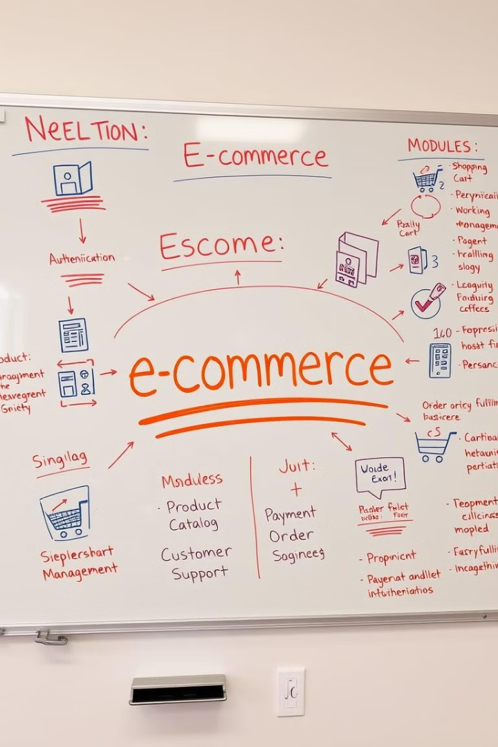
Module
The website will be organized into several key modules to manage different aspects of the e-commerce operations.
Module
Description
User Authentication
Allows users to create accounts, login, and manage their profile information.
Product Catalog
Displays various bedsheet styles with detailed descriptions, images, and pricing information.
Shopping Cart
Enables users to add items to their cart, view their cart contents, and proceed to checkout.
Payment Processing
Integrates with secure payment to facilitate online transactions.
Order Fulfillment
Manages order processing, tracking, and shipping to ensure timely delivery.
Customer Support
Provides a platform for customers to contact support with questions or concerns.

Slide 8
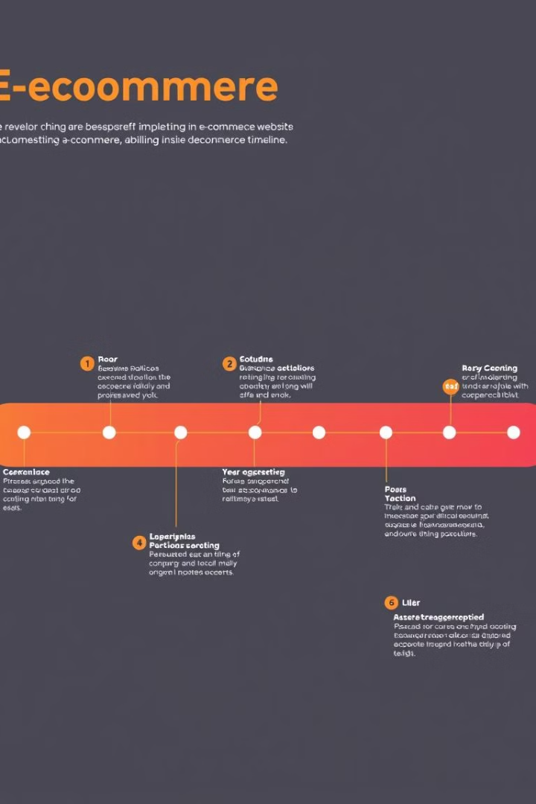
Workflow/Gantt Chart
The development process will be divided into distinct phases with specific tasks and timelines.
1
Phase 1: Requirements Gathering
Collecting user requirements, market research, and competitor analysis.
2
Phase 2: Design & Development
Creating website mockups, front-end development, back-end development, and database integration.
3
Phase 3: Testing & Deployment
Thorough testing, quality assurance, and deployment on a live server.
4
Phase 4: Maintenance & Updates
Regular maintenance, bug fixes, and feature updates to ensure optimal performance.

Slide 9





Reports
Regular reports will be generated to track key metrics and performance indicators.
Sales Reports
Monthly sales figures, revenue generated, and average order value.
Customer Demographics
Analyzing customer data to understand their preferences, buying habits, and demographics.
Website Traffic
Monitoring website visits, bounce rate, and average time spent on the website.
Conversion Rates
Tracking the percentage of visitors who complete a purchase on the website.
Marketing Campaign Performance
Evaluating the effectiveness of marketing campaigns in terms of reach, engagement, and conversion rates.

Slide 10
References
The following references were consulted during the development of this project.
E-commerce Best Practices Guide
Web Development with Next.js
User Interface Design for E-commerce Websites
Digital Marketing Strategies for Online Businesses

